Slide 1
Opening the black box of Deep Neural Networks via Information
郝雅茹
12/31/2021

Slide 2
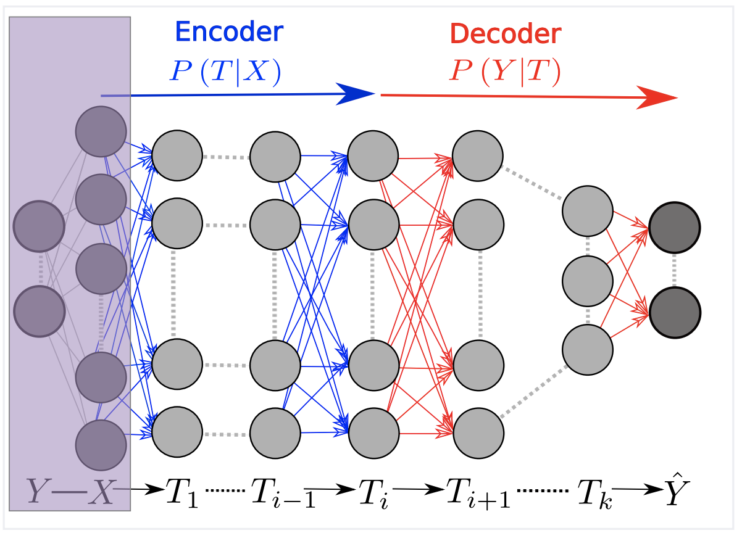
DNNs and Information
P(X, Y)
Markov chain

Slide 3
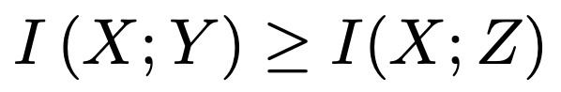
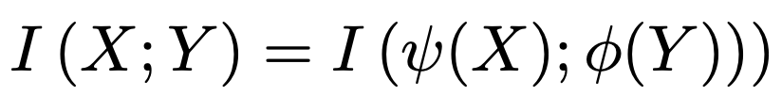
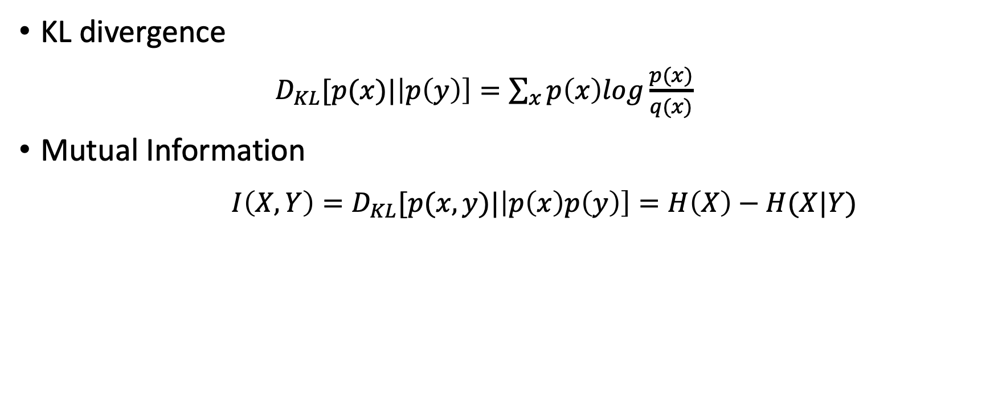
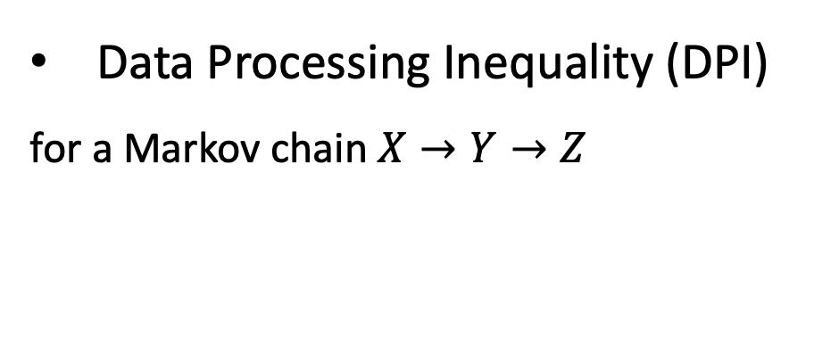
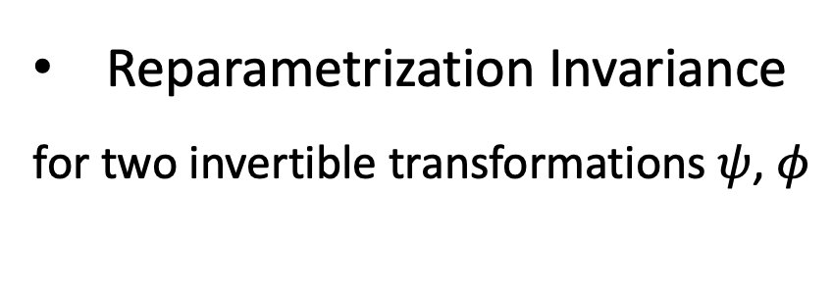
Information Theory basics
KL divergence
$D_{KL}[p(x)|\left|p\left(y\right)\right]=\sum_{x}{p\left(x\right)log}\frac{p(x)}{q(x)}$
Mutual Information
${I\left(X,Y\right)=D}_{KL}[p(x,y)|\left|p\left(x\right)p\left(y\right)\right]=H\left(X\right)−H(X|Y)$
Data Processing Inequality (DPI)
for a Markov chain $X→Y→Z$
Reparametrization Invariance
for two invertible transformations $ψ$, $φ$

Slide 4
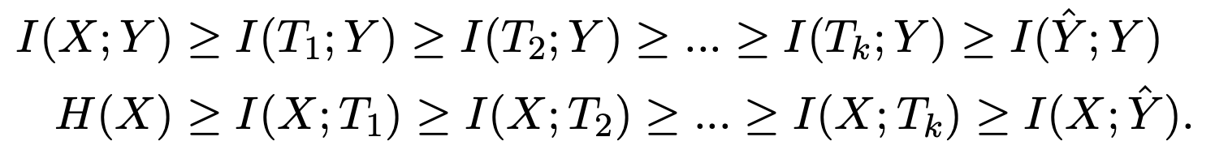
DNNs and Information
I(X,T)
I(T,Y)
sample
complexity
ACC
2 phases of training
Predict Y
Compress X

Slide 5
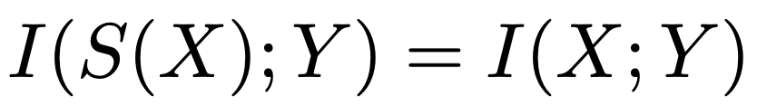
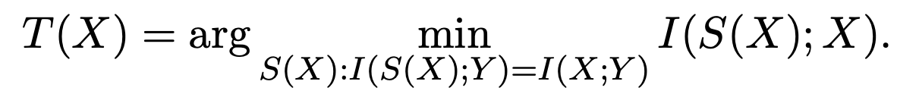
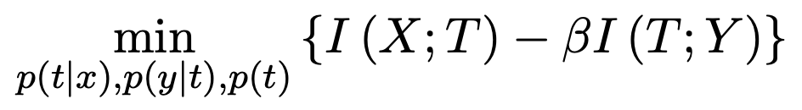
Information Bottleneck (IB)
Sufficient statistics
Minimal Sufficient statistics
Information Bottleneck
search for approximate minimal sufficient statistics
tradeoff between predicting Y and compressing X

Slide 6
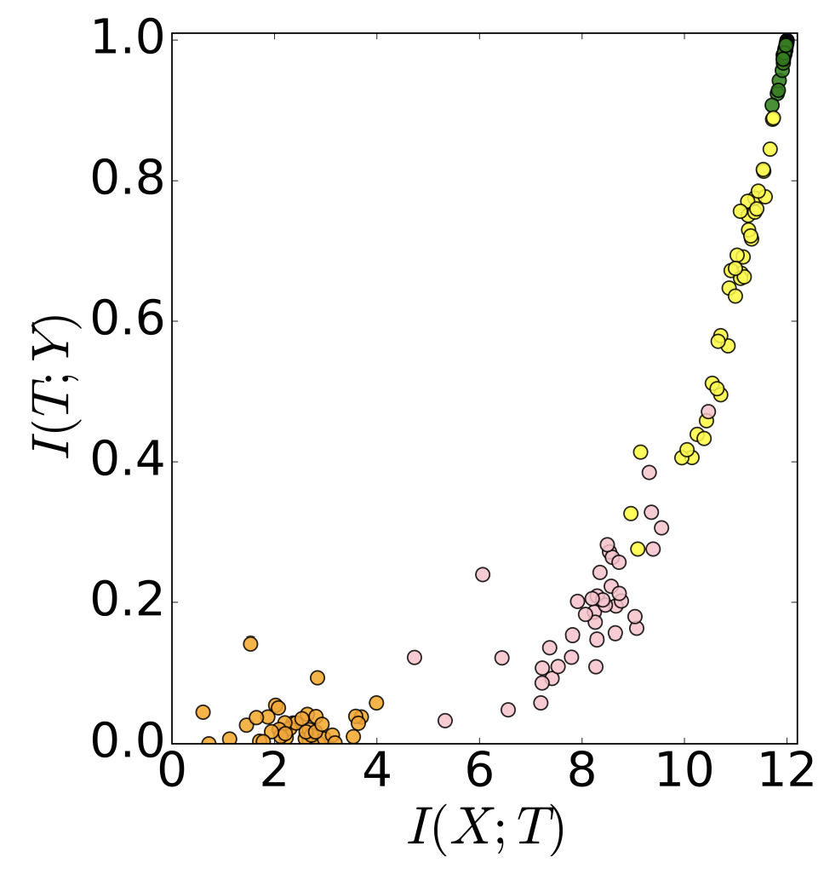
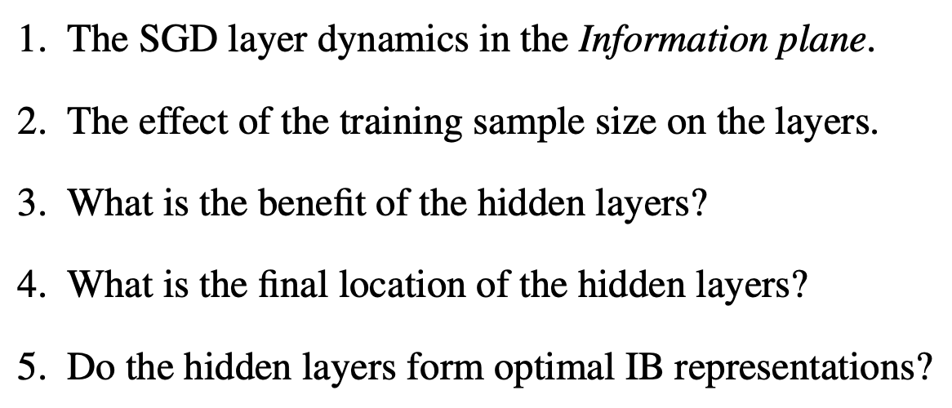
Visualize DNNs in the Information Plane

Slide 7
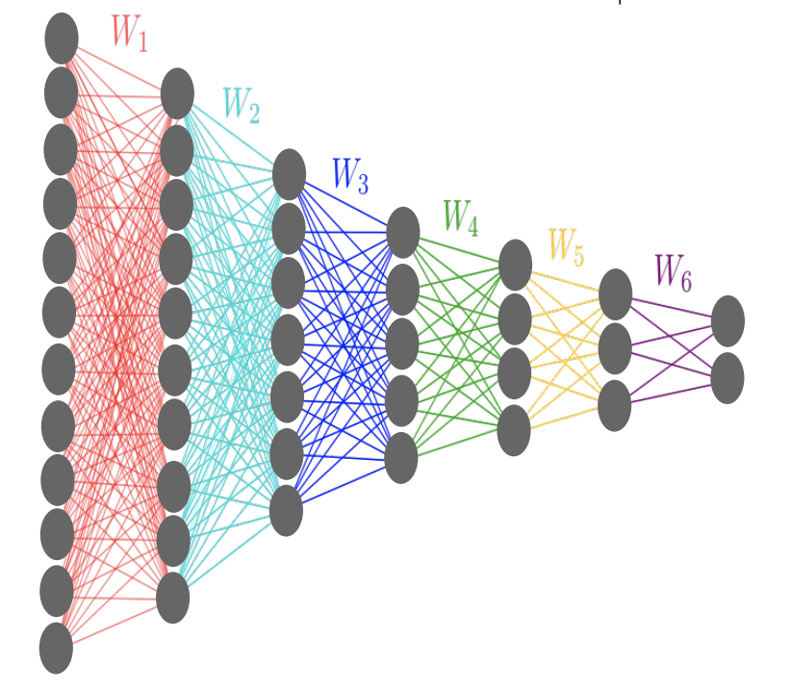
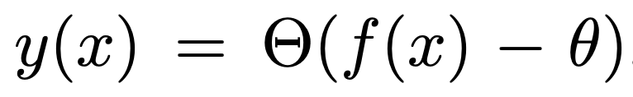
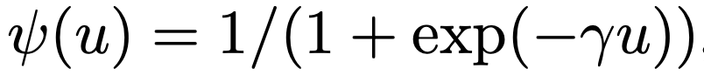
Experiments Setup
Network
Generate P(X, Y)
Input: x (12 bits)
map x by a real valued function f(x)
produce the label by
spherical harmonics power spectrum
12-10-7-5-4-3-2 neurons
SGD, tanh activation

Slide 8
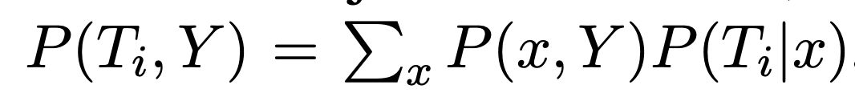
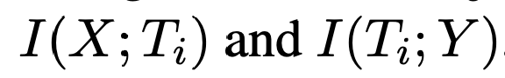
Experiments Setup
Estimate MI
Generate P(X, Y)
we binned the neuron’s arctan
output activations into 30 equal
intervals between -1 and 1
Input: x (12 bits)
map x by a real valued function f(x)
produce the label by

Slide 9
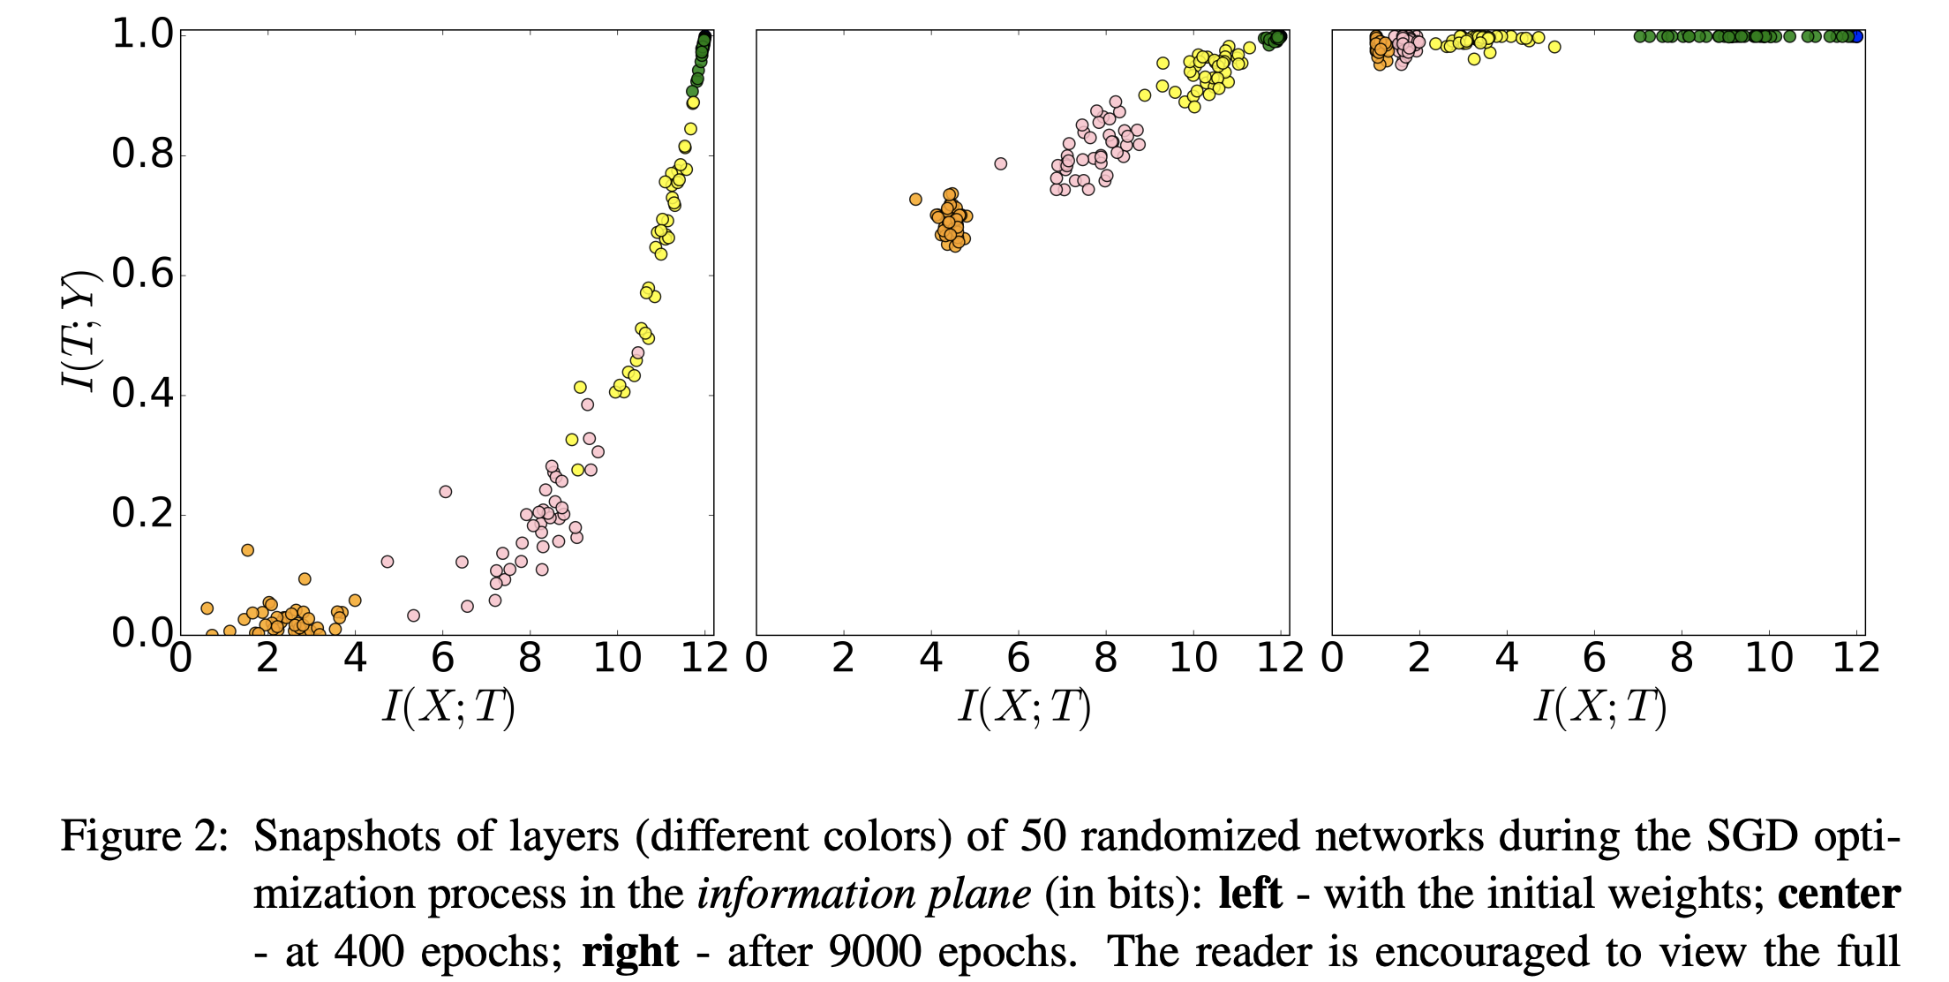
The dynamics of the training by SGD

Slide 10
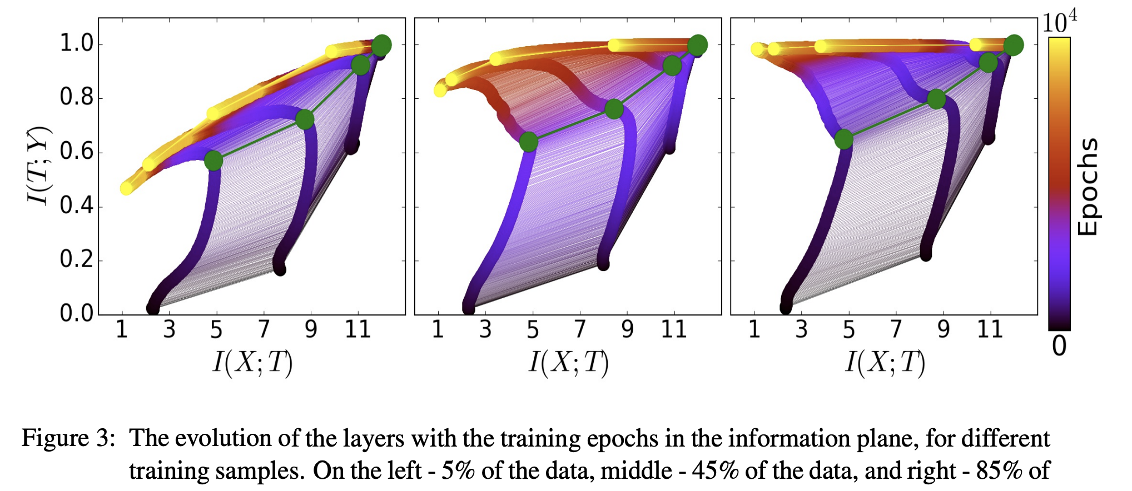
The two optimization phases in the Information Plane(training sample size)

Slide 11
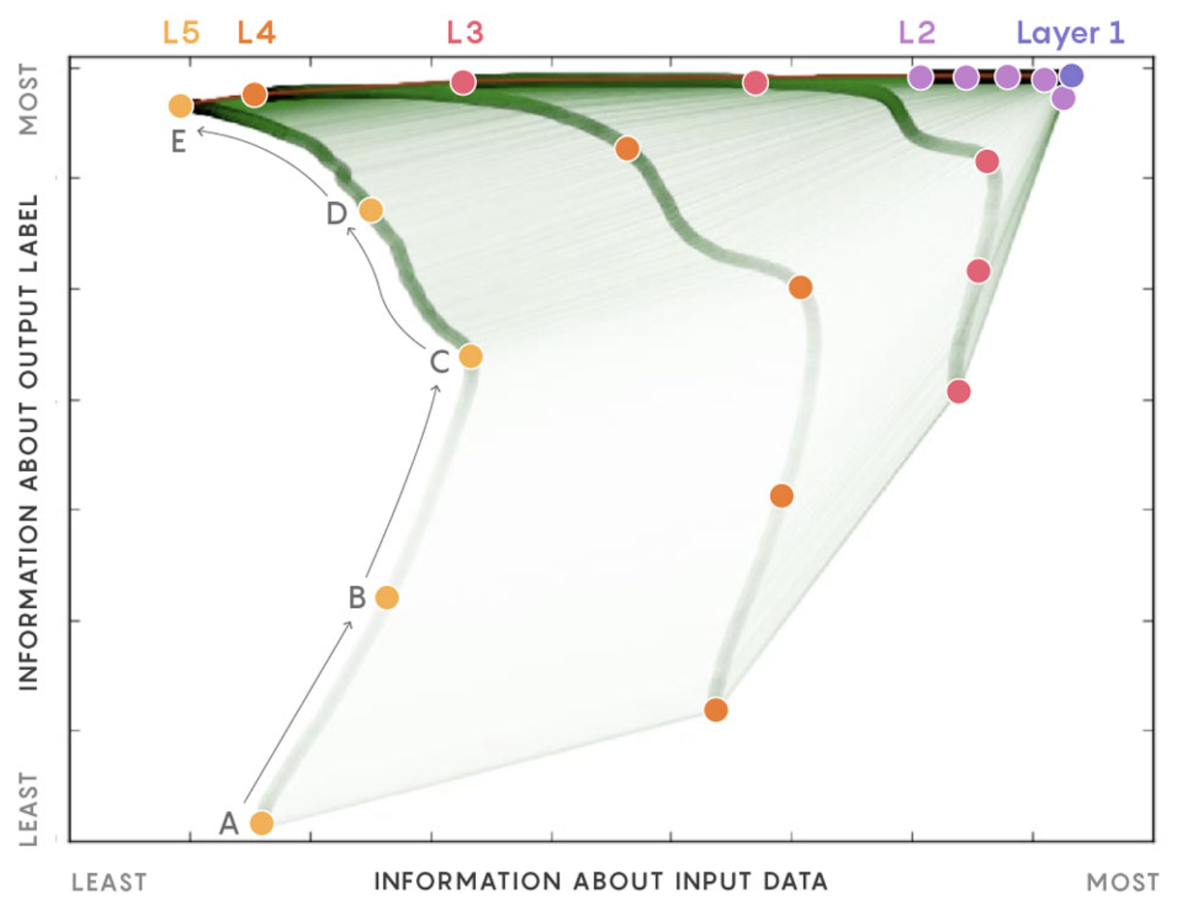
The two optimization phases in the Information Plane

Slide 12
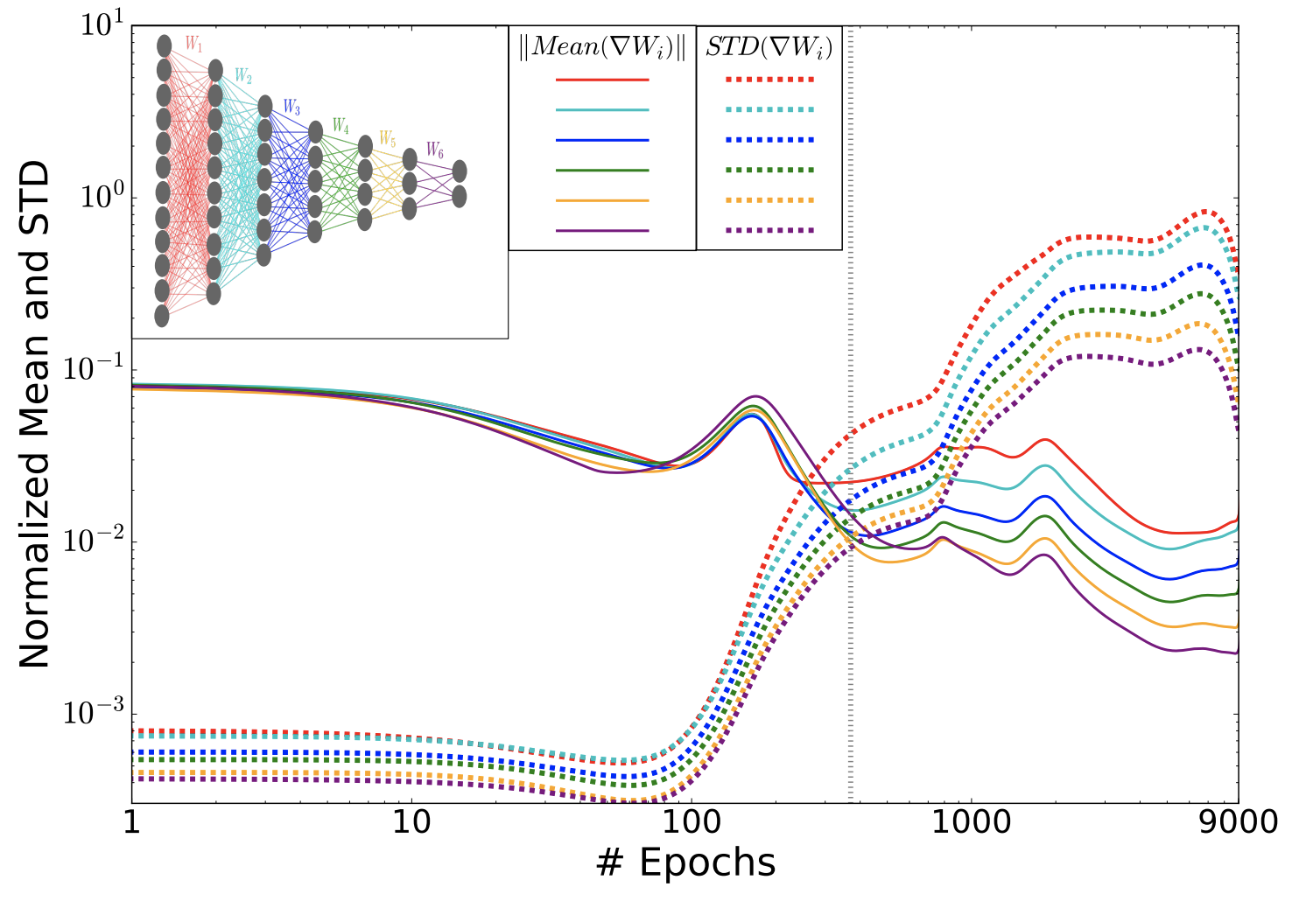
The drift and diffusion phases of SGD optimization
drift
diffusion

Slide 13
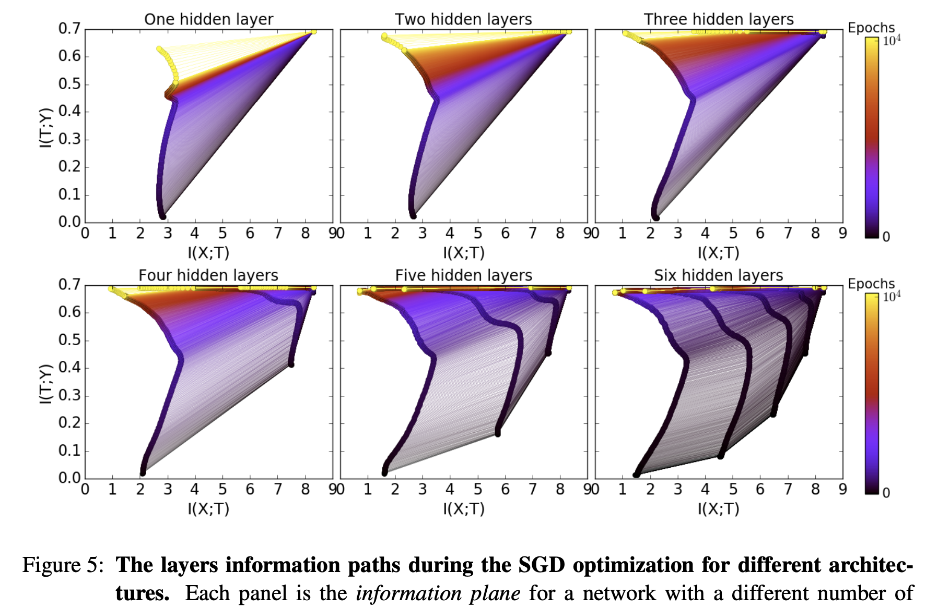
The computational benefit of the hidden layers
adding hidden layers reduce
the training epochs
2. The compression phase of each layer
is shorter when it starts from a previous
compressed layer.
3. The compression is faster for the
deeper layers

Slide 14
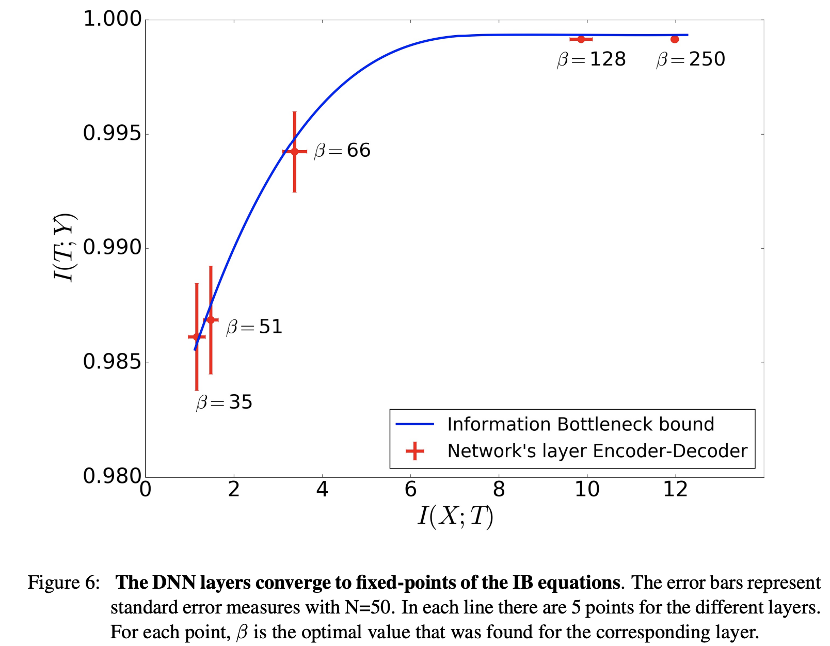
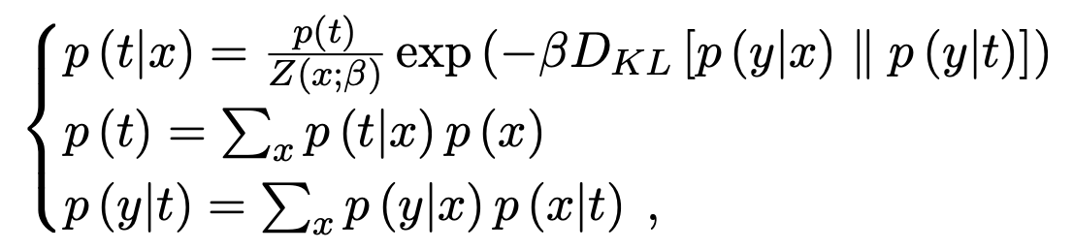
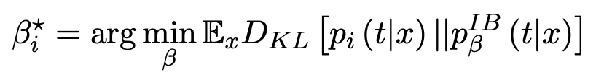
Convergence to the layers to the IB bound
IB

Slide 15
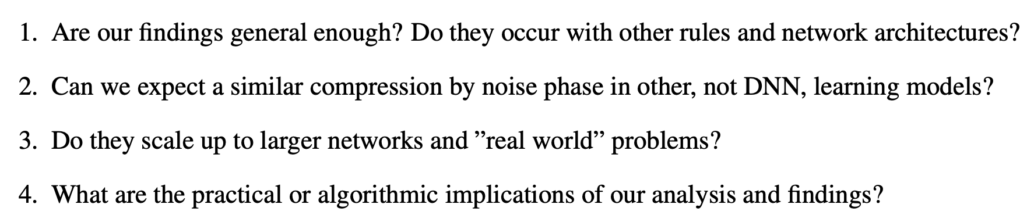
Discussion

Slide 16
Resources
Paper1: https://arxiv.org/pdf/1703.00810.pdf
Paper2: https://arxiv.org/pdf/1503.02406.pdf
Blog: https://lilianweng.github.io/lil-log/2017/09/28/anatomize-deep-learning-with-information-theory.html
Talk: https://www.youtube.com/watch?v=bLqJHjXihK8

Slide 17
Thanks

